Slide 1

FITNESS TRACKER POWERED BY “POWER BI”

Slide 2
About me
Background:
Name: Patil Bharath Sai
University : Kalasalingam Academy of Research and Education, Virudhunagar, Tamil Nadu.
Education : B-tech, Computer and Science Engineering in Artificial Intelligence and Machine Learning.
Why I want to learn Data Science:
  I am highly motivated to understand how data-driven insights can solve real-world problems
  It has high demand profession and have many career path opportunities
  Influencing decision-making and driving innovation
Work Experience: 4 Internship – 6 months Experience in 3 years
      DevTown – Data Science Intern
      Bharat Intern – Machine Learning
      My Company – Backend Developer
      Forage – Accenture Data Analyst
      LinkedIn : Patil-bharath-sai-b7065027a/
      GitHub : https://github.com/PATIL-BHARATH-SAI

Slide 3
Agenda
PROBLEM STATEMENTS
SOURCE OF DATASET
SUMMARY OF THE DATASET
DASHBOARDS EXPLANATIONS
CONCLUSION

Slide 4
PROBLEM STATEMENTS
PROBLEM STATEMENT - 1 : OVERALL BUSINESS PERFORMANCE.
PROBLEM STATEMENT - 2 : MONTHLY PERFORMANCE TRACKING.
PROBLEM STATEMENT - 3 : MEMBERSHIP STATUS TRACKING.
PROBLEM STATEMENT - 4 : FITNESS & HEALTH CALCULATIONS.
PROBLEM STATEMENT - 5 : CLIENT DETAILED PROFILE.

Slide 5
SOURCE OF THE DATASET
The dataset has been downloaded from “THE DEVELOPER” WEBSITE.
This website provide some great & cleaned datasets.
Those databases are very useful for beginner power bi developers.
link : https://docs.google.com/spreadsheets/d/1RaxystOZCaUaFOAahTHUufomcq0tSi-h/edit?usp=drive_link&ouid=117705500000065924368&rtpof=true&sd=true
Link:

Slide 6
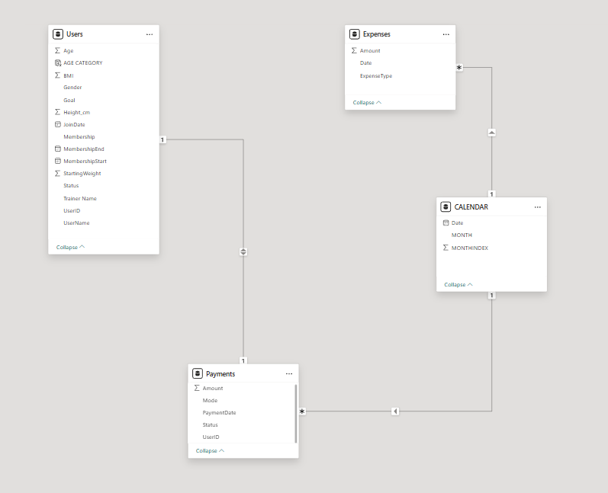
SUMMARY OF THE DATA

Slide 7
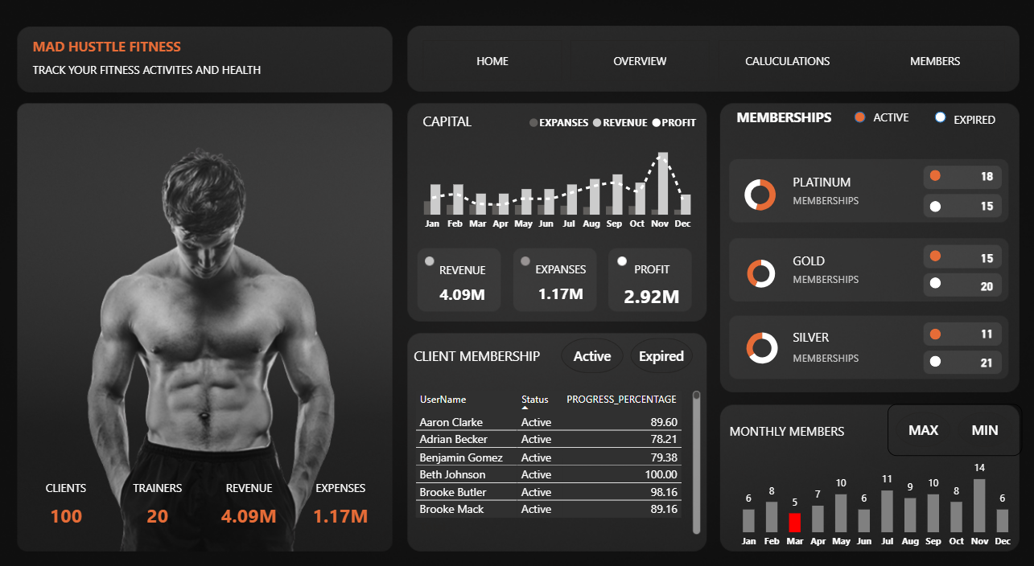

Slide 8
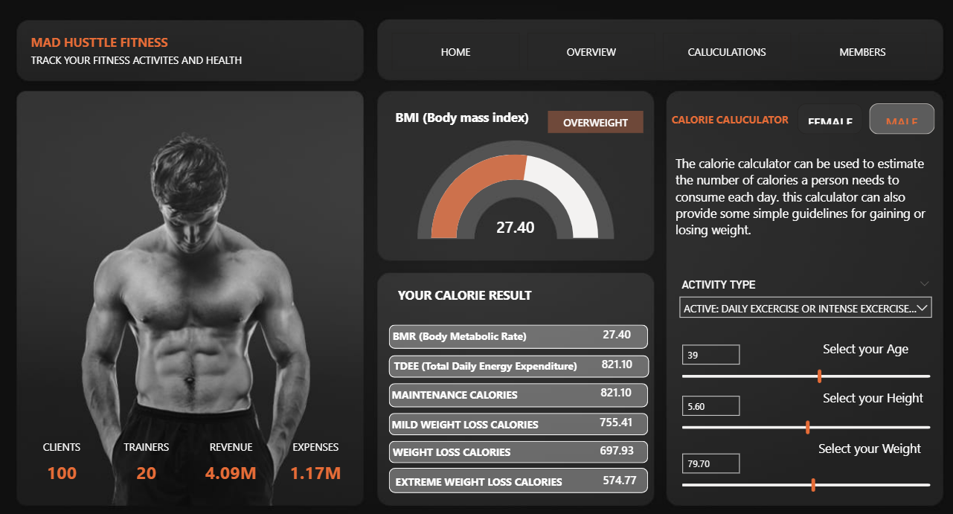

Slide 9
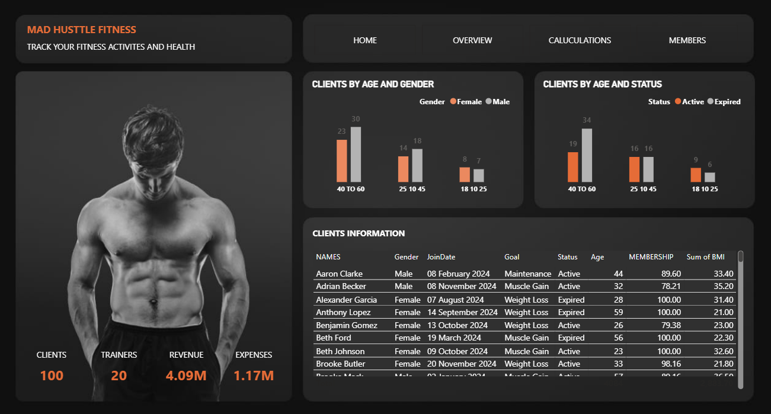

Slide 10

THANK YOU
Thank you for your time!
Feel free to connect on LinkedIn or GitHub.

